Slide 1
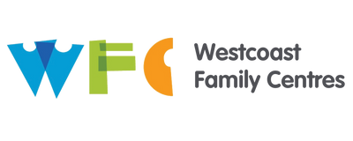
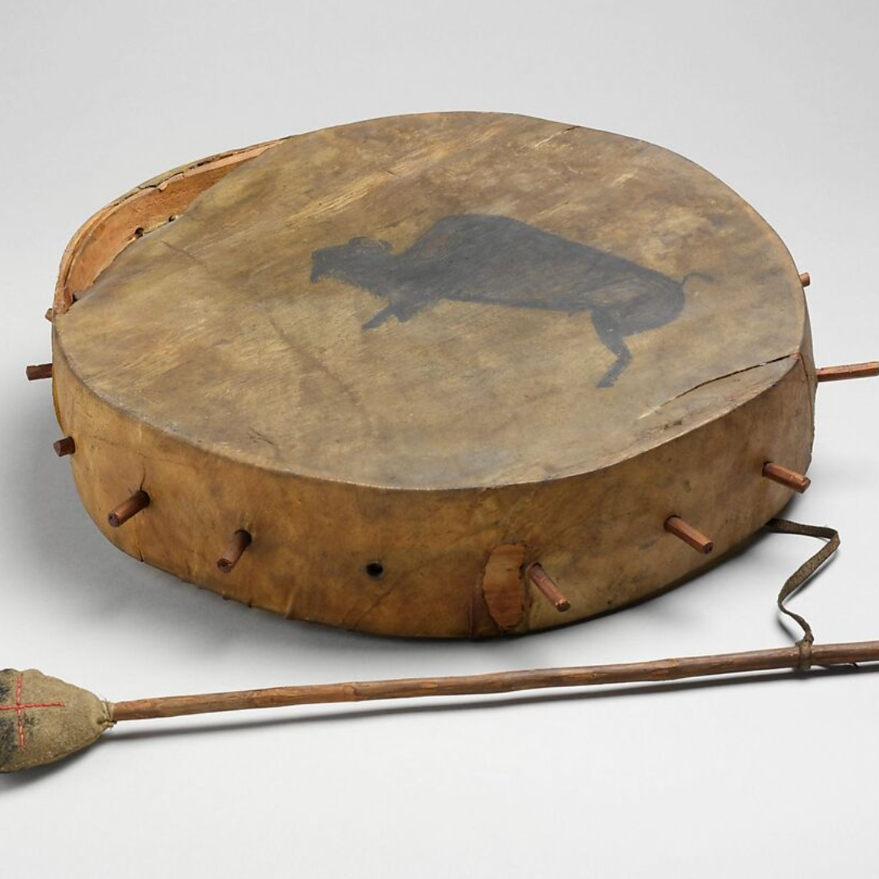
Indigenous Education Consultant
Vancouver Family Preservation and Reunification Services

Slide 2
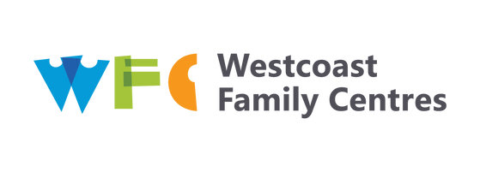
Westcoast Family Centres is privileged to offer person-centered services on the unceded territory of the kʷikʷəƛ̓əm (Kwikwetlem) First Nation, q̓ic̓əy̓ (Katzie) First Nation, Kwantlen First Nation, and the Coast Salish People including the territories of the xʷməθkʷəy̓əm (Musqueam), Skwxwú7mesh Úxwumixw (Squamish), and səl̓ilwətaɁɬ (Tsleil-Waututh) Nations.​
​
Our agency stands in solidarity with all Indigenous Nations to repatriate their children back to their home communities ​
and nations.

Slide 3
MISSION
VISION
Westcoast Family Centres Society strengthens relationships between children and families and between families and their communities.
All families reach their full potential.

Slide 4
Vancouver Family Preservation and Reunification Services
Program Overview
Family Services of Greater Vancouver (FSGV), in partnership with Westcoast Family Centres Society (WFCS), deliver non-residential Family Preservation and Reunification Services to children, youth, and their families and caregivers across the City of Vancouver.
Indigenous Education Consultant – Vancouver Family Preservation and Reunification Services
Once a referral is received into VFPRS services, if the family are self-identifying as Indigenous, our Indigenous Education Consultant will be added to the file as a secondary counsellor along with the allocated workers, this is true for the follow programs
Supervised Access
Family Preservation, except where the file has been allocated to an Indigenous Family Preservation Worker, IEC can supplement work done but will not be automatically involved in these files as they will have cultural support through their allocated worker
Co Parenting Support Program
Clinical Counselling
Resource and Home Support files, if standalone referrals
Crisis Response files
Child and youth care intervention

Slide 5
Our Indigenous Education Consultant supports WFC and FSGV Workers and families in VFPRS working with Indigenous Families, except where an Indigenous Family Counsellor has been allocated, in which case they would undertake this role, this support includes;
Attending intake meetings to discuss the Indigenous consultant role and any culturally related goals the family may have.
Creating culturally specific service goals for each of our indigenous families who have identified this as a service they would like, specific to their cultures, beliefs, heritage and practice
Connect families to their communities and culturally specific supports and opportunities for teachings.
Helps support families and indigenous persons get status, registration and access Jordan’s principle.

Slide 6
The Indigenous Education Consultant also performs the following roles
Groups and workshops
Runs specific groups and workshops for Indigenous families, care givers and children such as building resilience, self care, accessing services, and caring for indigenous children.
Run culturally sensitive events for Indigenous families which aim to reduce barriers preventing them from accessing services.
Provide training and teachings, through workshops and learning circles, for WFC and FSGV staff around services and supports available for Indigenous families as well as teachings on how to work in a culturally sensitive and appropriate manner with indigenous families and communities.

Slide 7




CONTACT
US
Phone
604-254-5457
Website
www.westcoastfamily.org
WestcoastFamilyCentres
westcoastfamctr
Westcoast Family Centres Society

